Slide 1
Employee Attrition Analysis and Prediction

Slide 2
Problem Explanation :
Employee turnover is a major challenge for organizations, leading to increased costs, reduced productivity, and disruptions in team operations. Understanding the key reasons behind employee attrition and predicting at-risk employees is crucial for implementing effective retention strategies.
The objective of this project is to analyze employee data, identify key drivers of attrition, and develop predictive models to enable proactive decision-making in workforce management.
Business Use Cases:
Employee Retention: Identify at-risk employees and implement targeted strategies to reduce turnover.
Cost Optimization: Reduce recruitment, training, and onboarding costs associated with high employee attrition.
Workforce Planning: Utilize predictive insights to design employee retention strategies aligned with organizational goals and improve overall job satisfaction.

Slide 3
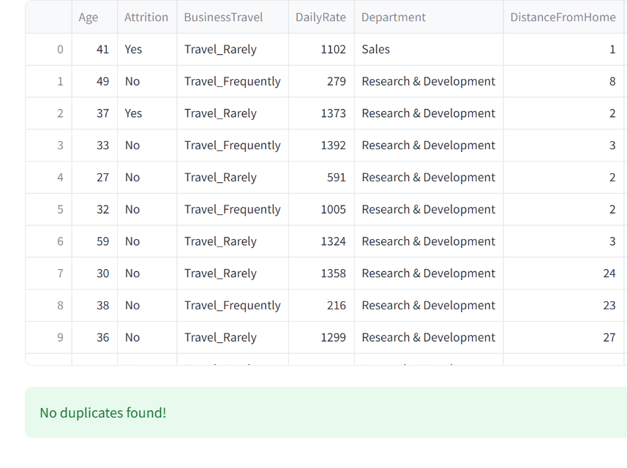
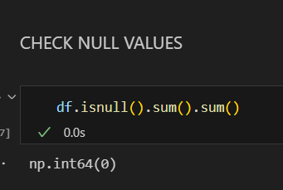
EDA
CHECK DUPLICATE VALUES

Slide 4
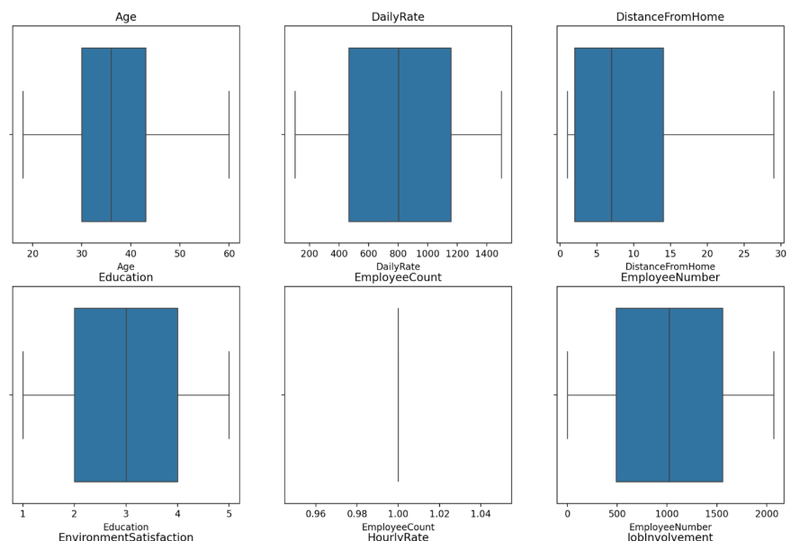
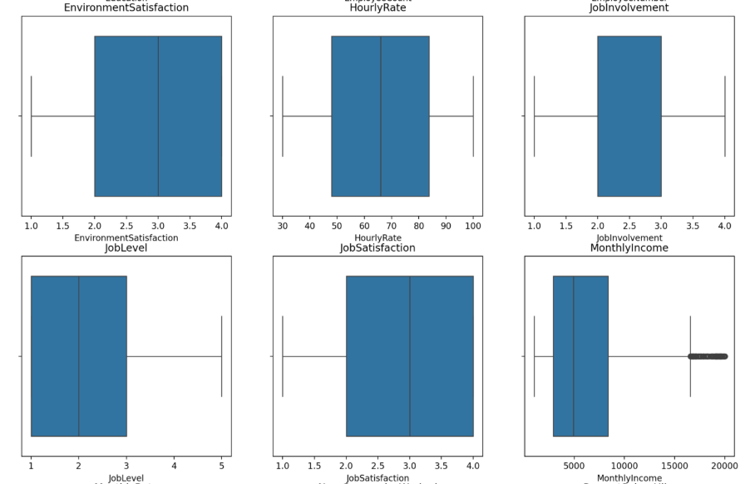
OULTLIERS

Slide 5
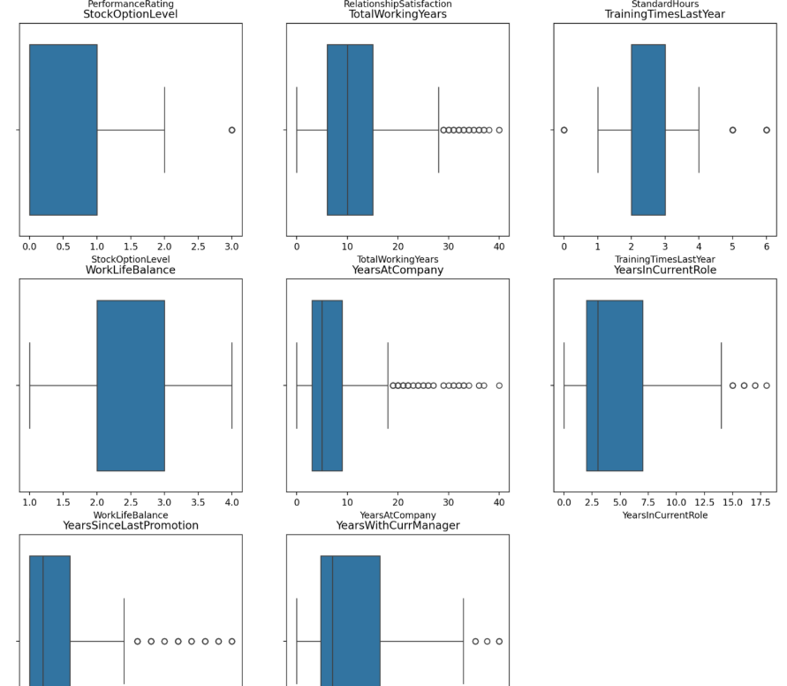
Outliers handling :
In this we have outliers in Columns: Monthly income, total working years, years at company, years in current role, year since last promotion, years with current managers.
Do Not Handle Outliers (Keep As Is):
Years at Company, Years in Current Role, Years Since Last Promotion, Years with Current Manager
These values represent career progression and tenure. Some employees may have unusually long tenures, which are realistic outliers. Removing them might lose valuable insights about long-term employees.
Consider Handling Outliers (Transform or Cap Values):
Monthly Income
Outliers in income could be due to executives or high-performing employees. If modeling for general employees, consider capping extreme values or using transformations (log transformation).
Total Working Years
Very high values may indicate errors or exceptional cases. Consider capping if necessary.

Slide 6
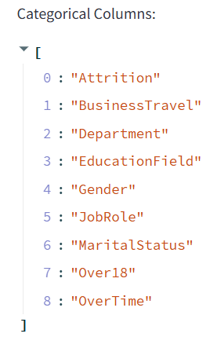
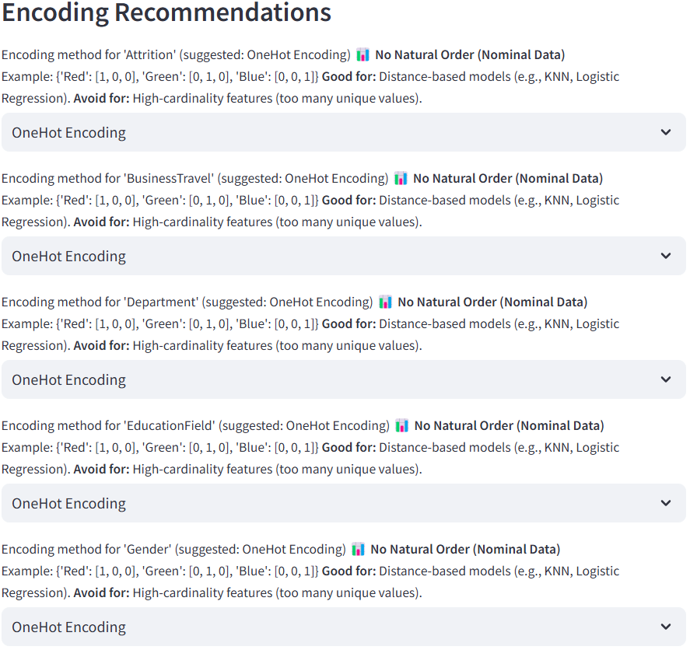

Slide 7
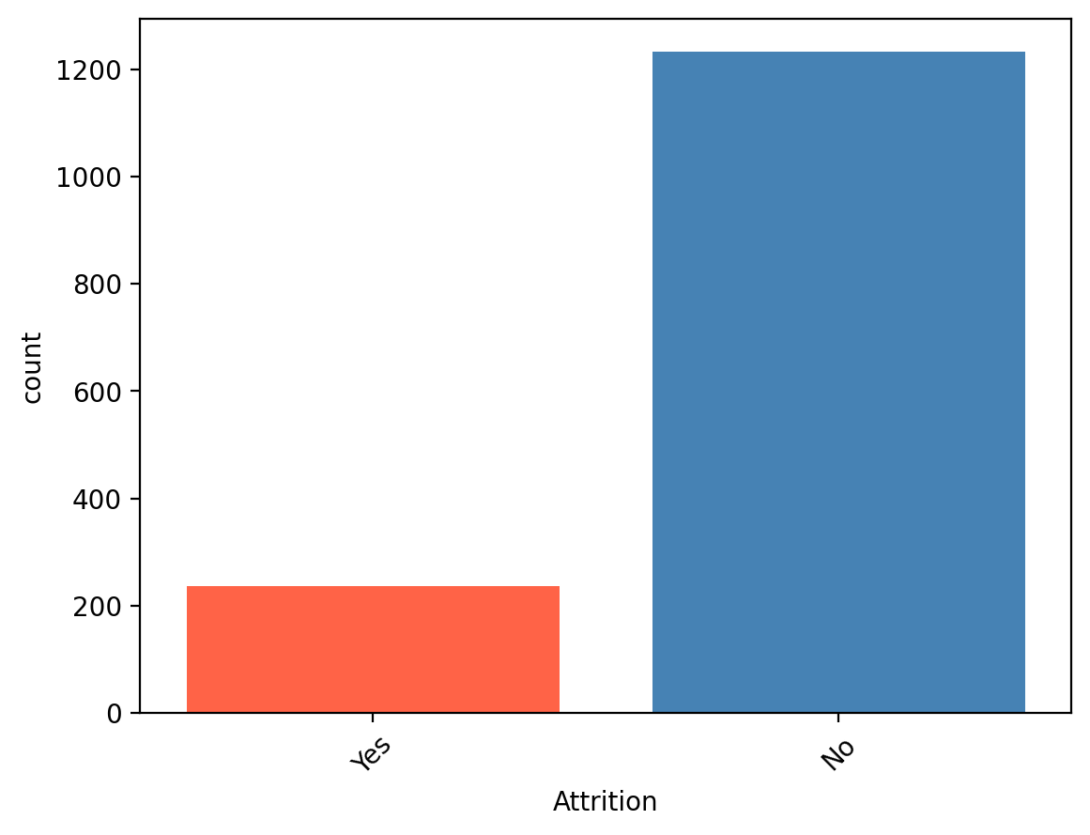
UNIVARIATE ANALYSIS - ATTRITION
Analysis of the Chart:
Imbalance in Attrition: The chart clearly shows a significant imbalance between employees who left the company ("Yes" attrition) and those who stayed ("No" attrition).
Low Attrition Rate: The number of employees who stayed is substantially higher than the number of employees who left. Approximately 1200 employees stayed, while around 230 employees left.
Quantifiable Attrition: We can quantify the attrition rate based on this data. Assuming the total number of employees is the sum of those who left and stayed (1200 + 230 = 1430), the attrition rate is approximately (230 / 1430) * 100% ≈ 16.08%.

Slide 8
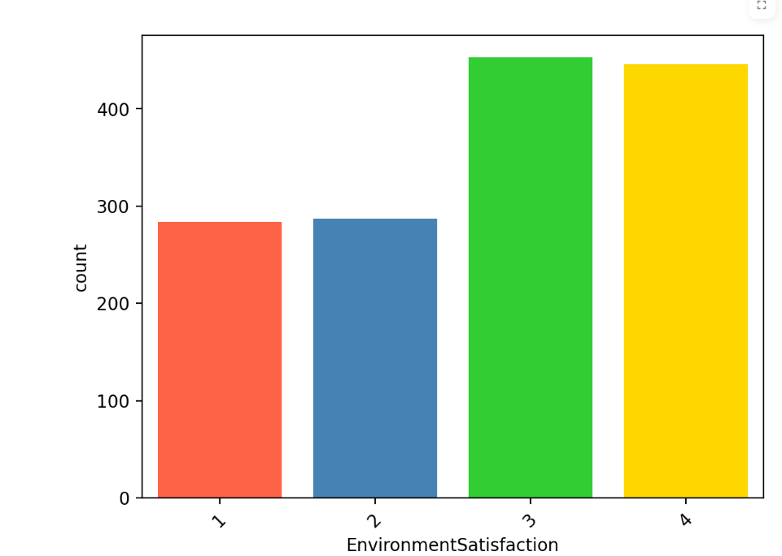
UNIVARIATE ANALYSE-ENVIRONMENTSATISFACTION
Analysis of the Chart:
Increasing Satisfaction: There's a noticeable trend of increasing employee count as the environment satisfaction level goes up.
Lowest at Level 1: The lowest number of employees reported the lowest level of environment satisfaction (level 1), with approximately 280 employees.
Slightly Higher at Level 2: The number of employees with a satisfaction level of 2 is slightly higher than level 1, at around 290 employees.
Highest at Level 3: The highest number of employees reported an environment satisfaction level of 3, with approximately 460 employees.
High at Level 4: The number of employees with the highest satisfaction level (level 4) is also high, with approximately 450 employees, slightly less than level 3.

Slide 9
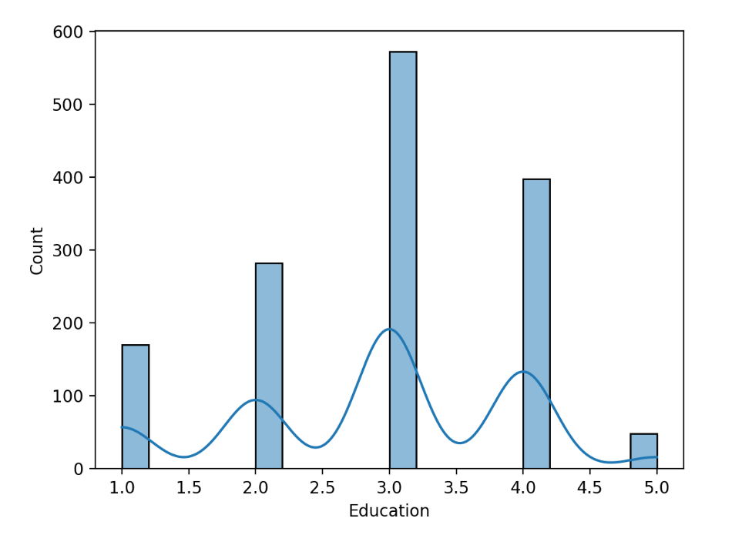
UNIVARIATE ANALYSE- EDUCATION

Slide 10
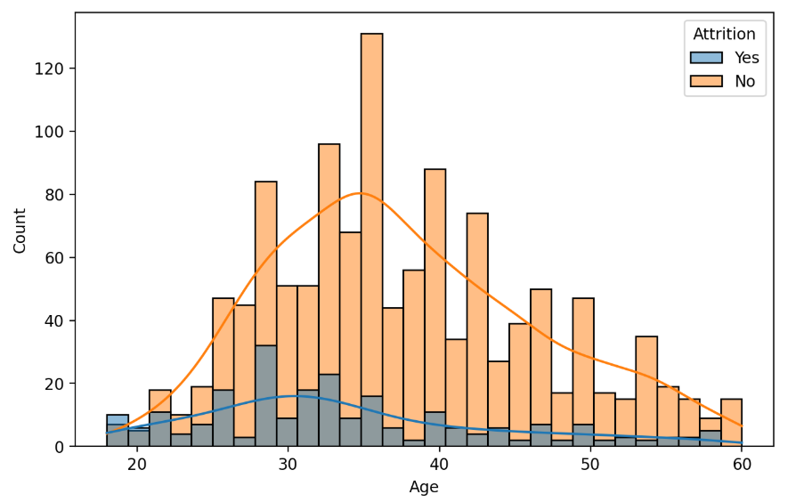
BIVARIATE ANALYSE – AGA VS ATTRITION
Analysis of the Chart:
Age Distribution of Stayed Employees (No Attrition):
The distribution for employees who stayed is centered around the mid-30s to early 40s.
There's a higher concentration of employees in this age range who have remained with the company.
The distribution appears somewhat bell-shaped but with a broader spread, indicating a wider range of ages among retained employees.
There's a noticeable peak around the late 30s.
Age Distribution of Left Employees (Yes Attrition):
The distribution for employees who left is more concentrated in the younger age groups, particularly from the early to late 20s and early 30s.
There's a distinct peak in attrition among employees in their late 20s and early 30s.
The KDE curve for attrition shows a higher probability of leaving for younger employees compared to older employees.
While attrition occurs across different age groups, it's

Slide 11
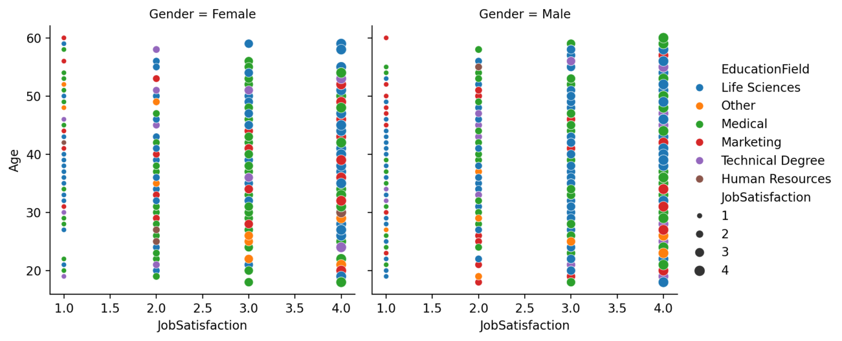
Analysis of the Chart:
General Observations (Across Both Genders):
Job Satisfaction Distribution: Employees with higher job satisfaction scores (3 and 4) appear to be more prevalent than those with lower scores (1 and 2) across all age groups and education fields. This is visually suggested by the larger size and higher density of points at the higher job satisfaction levels.
Age Range: The employees in this dataset range from approximately 18 to 60 years old.
Education Field Representation: All the listed education fields (Life Sciences, Other, Medical, Marketing, Technical Degree, Human Resources) are represented across different levels of job satisfaction and age.

Slide 12
observations by Gender:
Female Employees:
Female employees are distributed across all job satisfaction levels and the entire age range.
There doesn't appear to be a strong visual correlation between age and job satisfaction for female employees based on this plot alone. Employees of various ages report different levels of job satisfaction.
All education fields are represented across the different job satisfaction levels for female employees.
Male Employees:
Similar to female employees, male employees are spread across all job satisfaction levels and the age spectrum.
Again, there's no clear visual trend indicating a strong linear relationship between age and job satisfaction for male employees in this visualization.
All education fields are also present across the different job satisfaction levels for male employees.
Impact of Education Field (Color Coding):
The different colors representing education fields are scattered across all job satisfaction levels and age groups within both gender categories. This suggests that job satisfaction and age are not solely determined by the field of education. Employees from various educational backgrounds can experience different levels of job satisfaction at different ages.

Slide 13
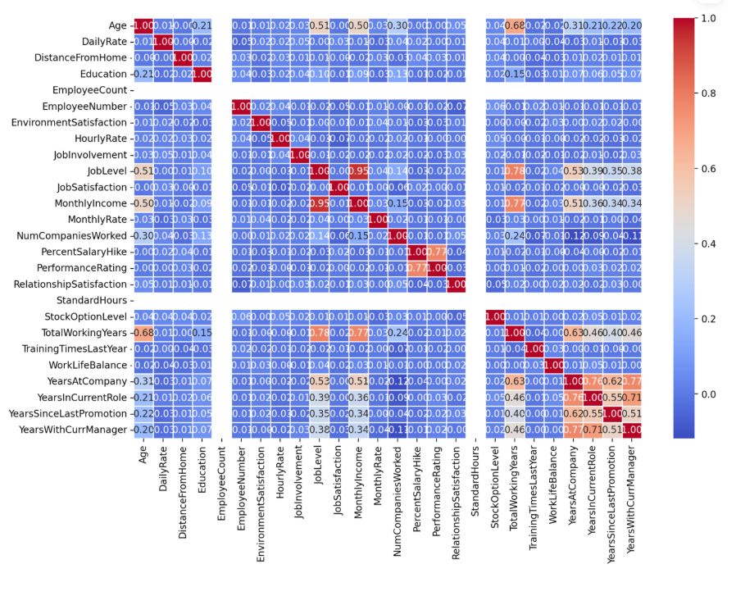
CORRELEATION

Slide 14
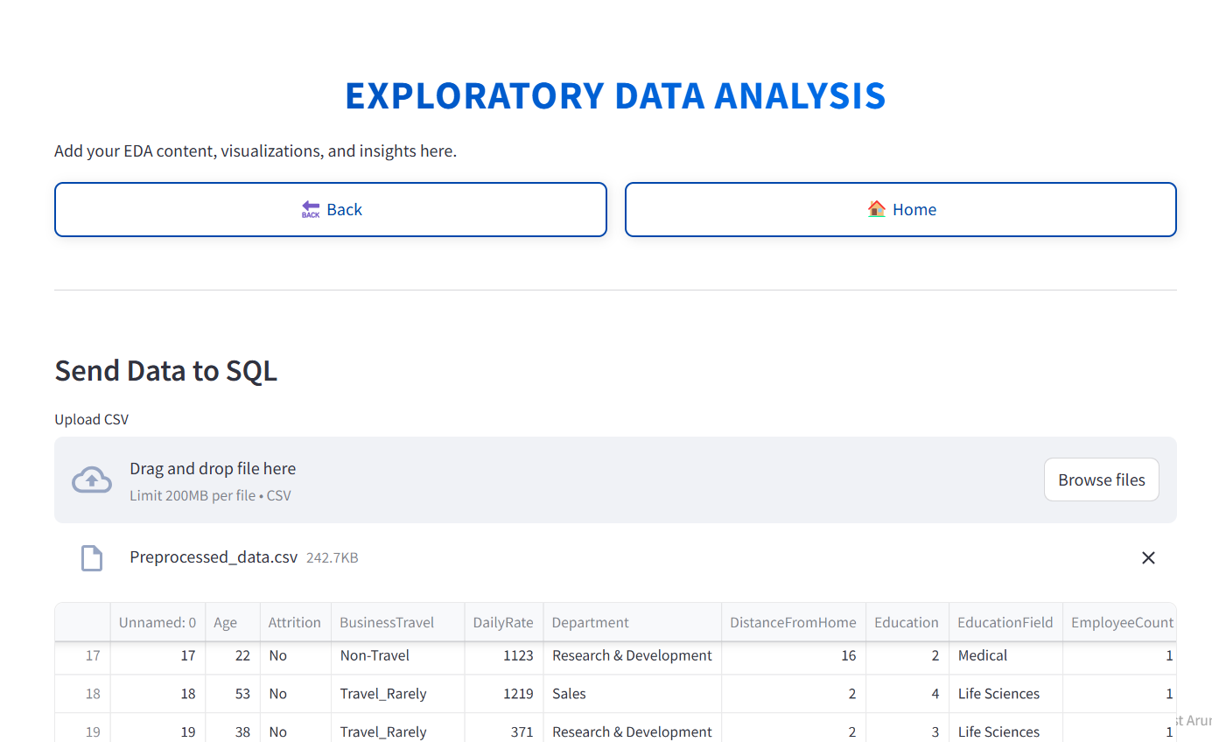
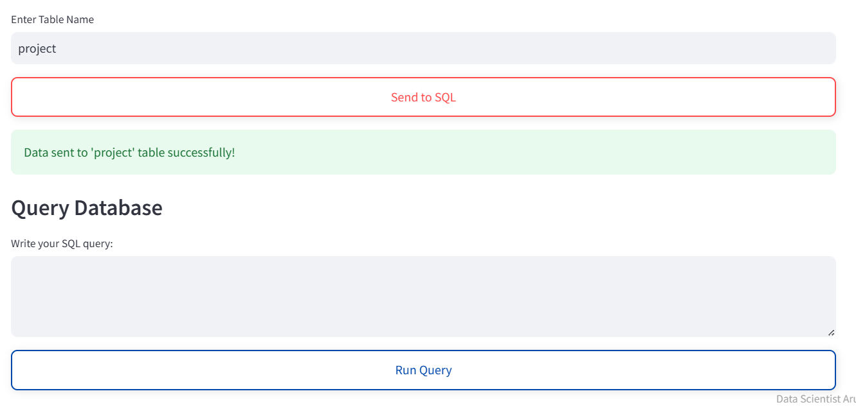
INSIGHTS WITH SQL

Slide 15
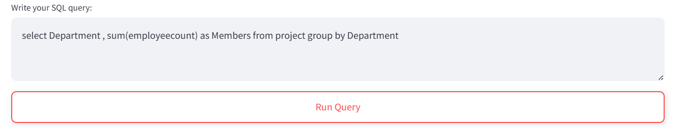
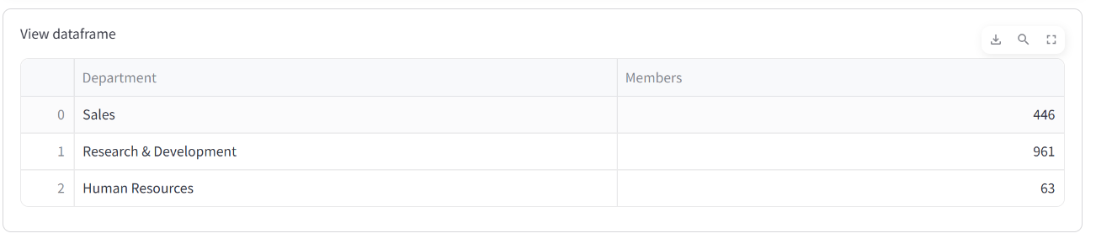
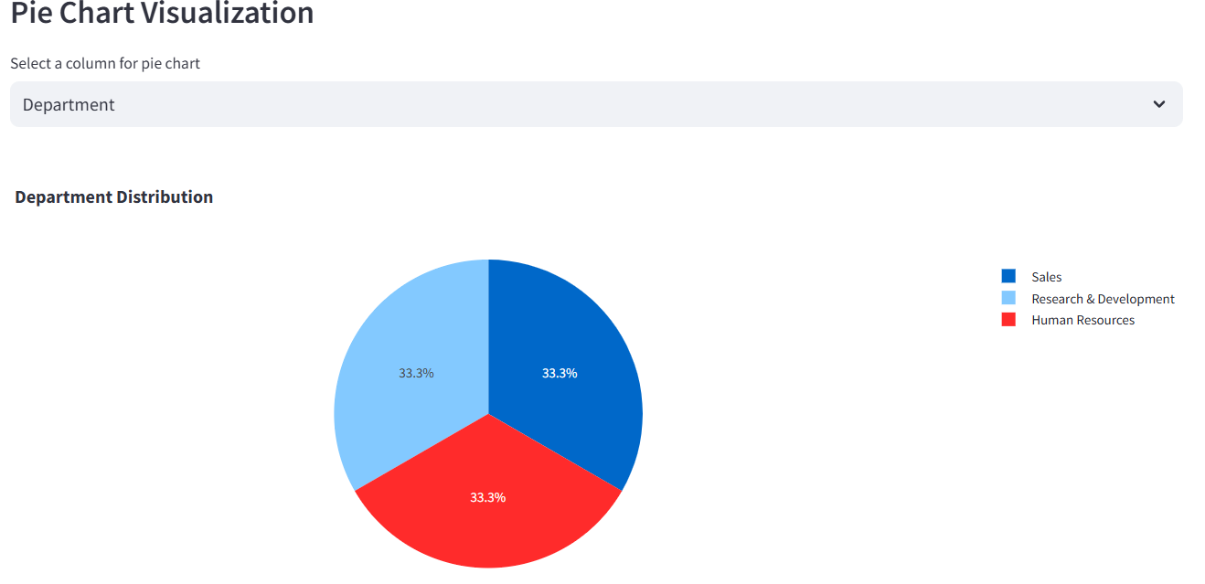
DEPARTMENT DISTRIBUTION WITH GROUP BY
NUMBER OF EMPLOYEE WORKING IN VARIOUS DEPARTMENT

Slide 16
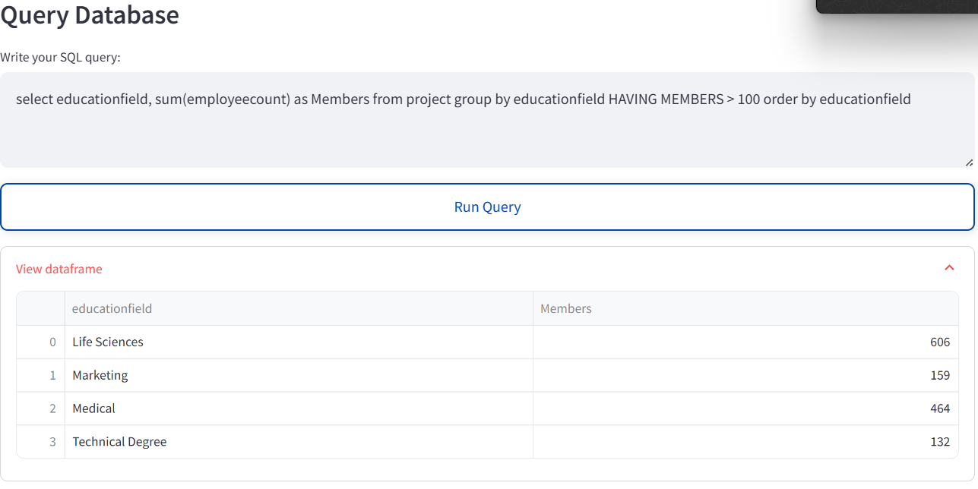
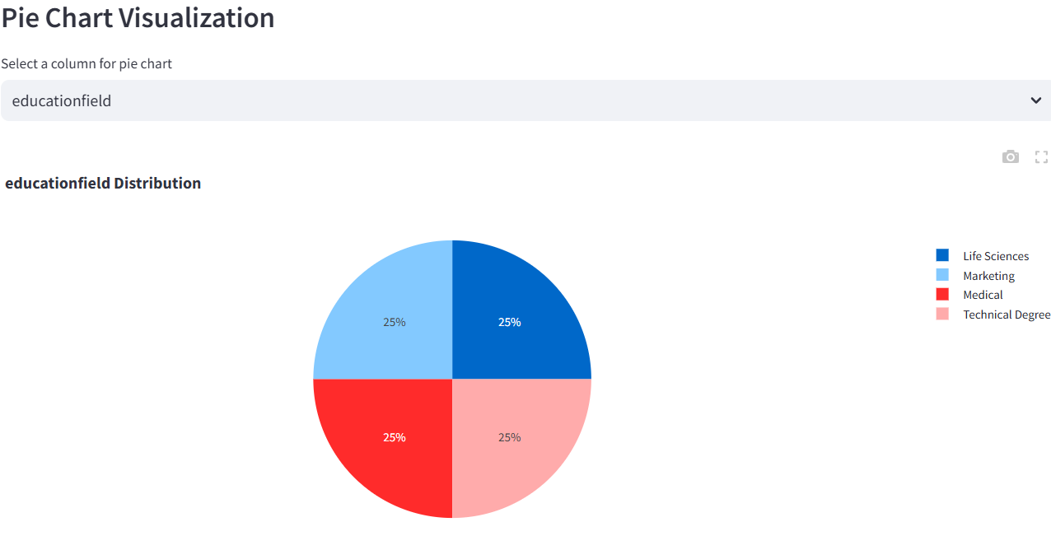
NUMBER OF EMPLOYEE FROM VARIOUS EDUCATION FIELD HAVING MORE THAN 100 EMPLOYEE [WITH HAVING]

Slide 17
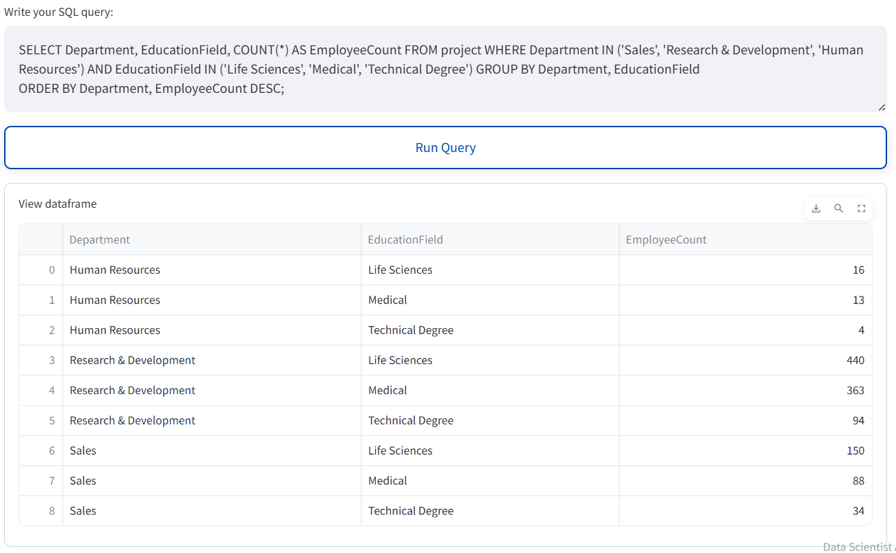
the count of employees in each combination of Department and EducationField,

Slide 18
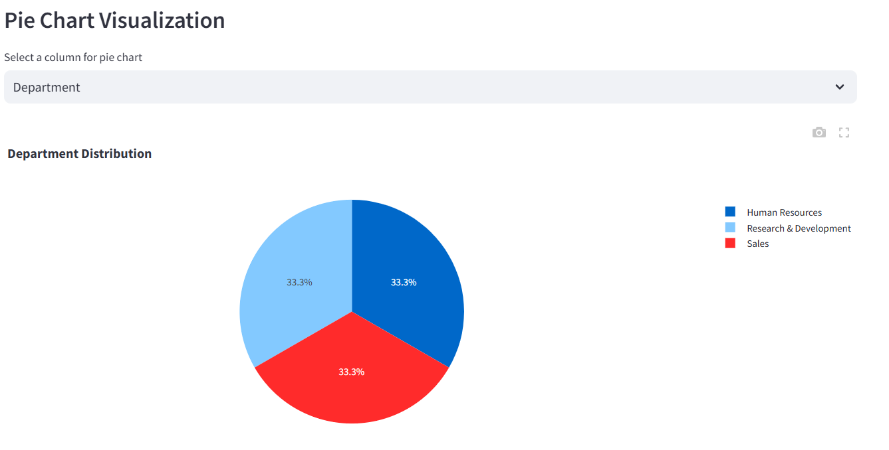

Slide 19
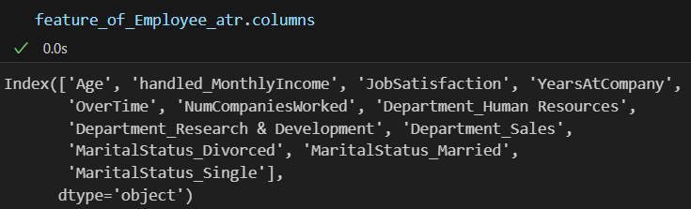
TARGET - ATTRITION

Slide 20
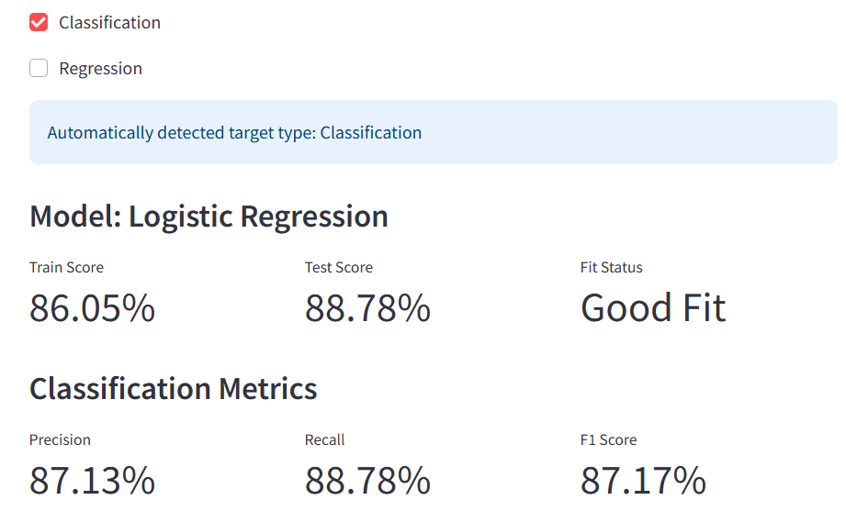
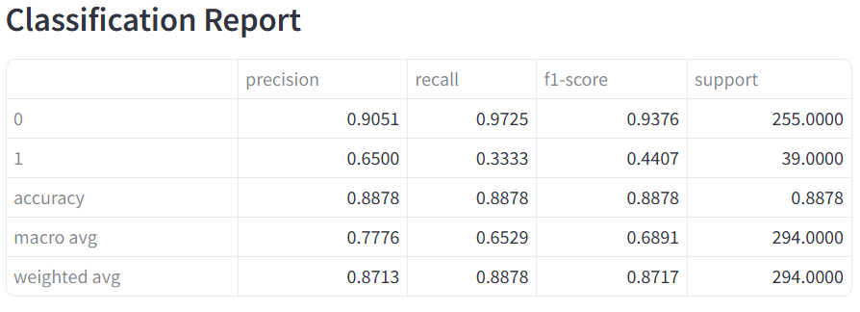
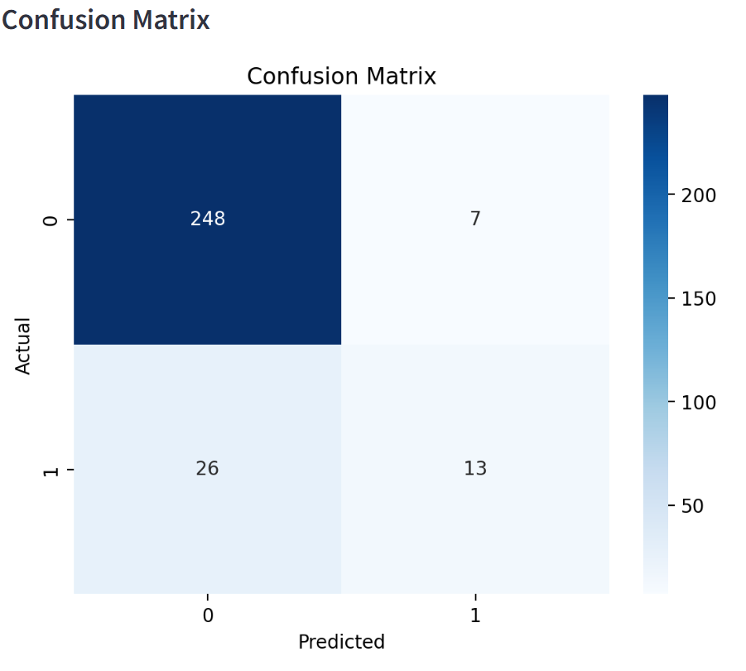
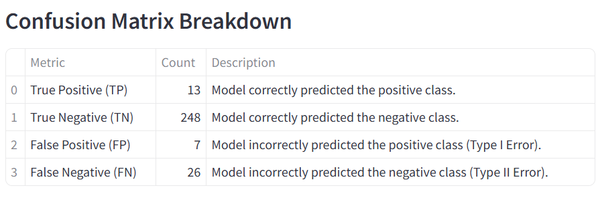
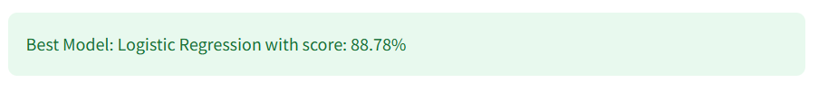
MODEL SELECTION – EMPLOYEE ATTRITION

Slide 21
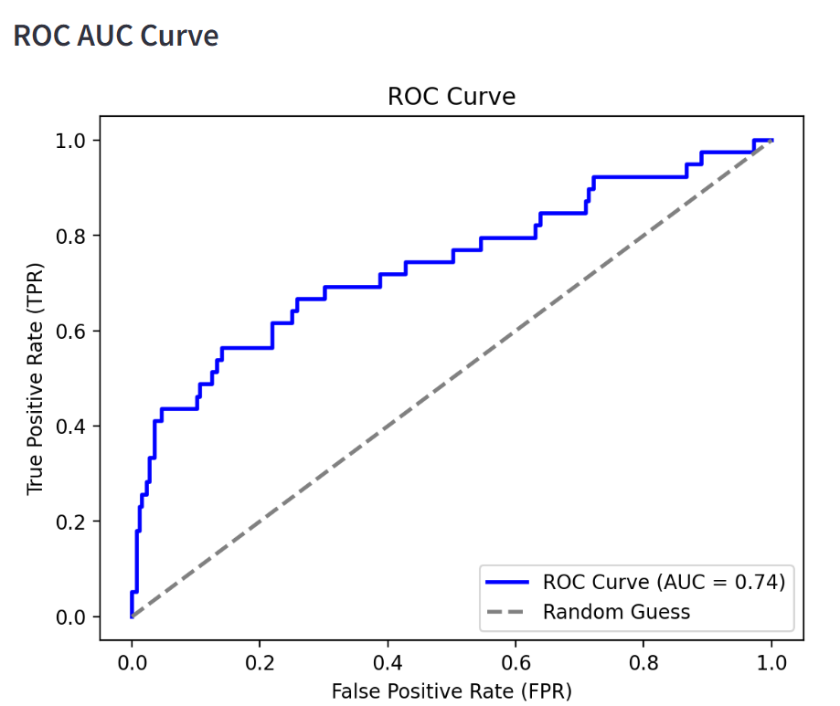


Slide 22
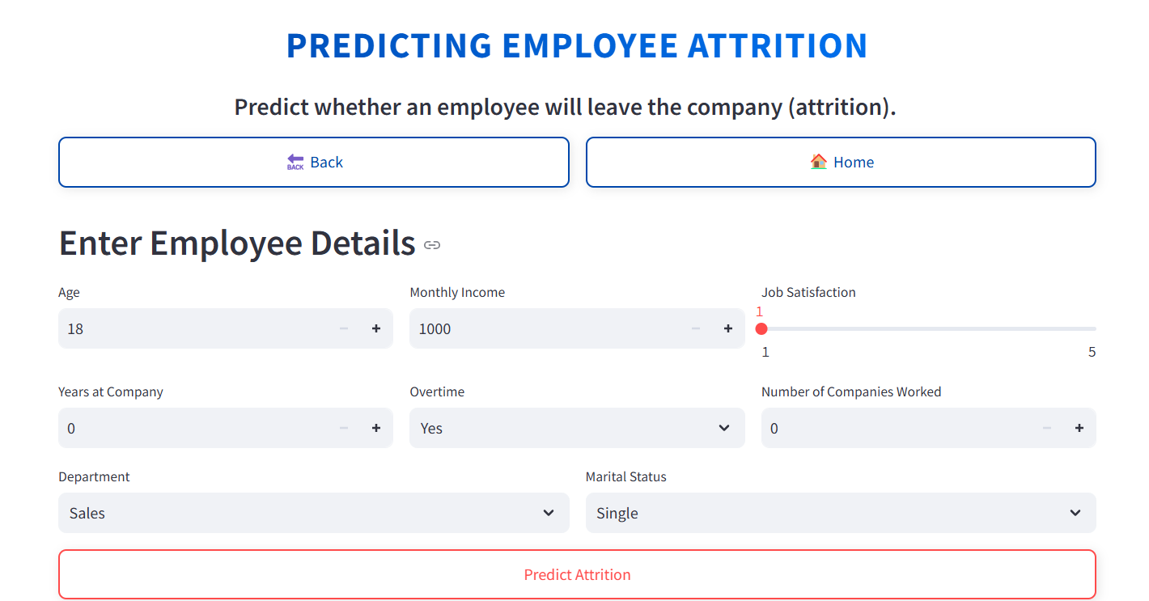
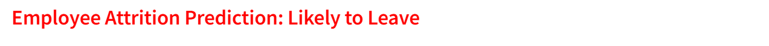
PREDICTION

Slide 23
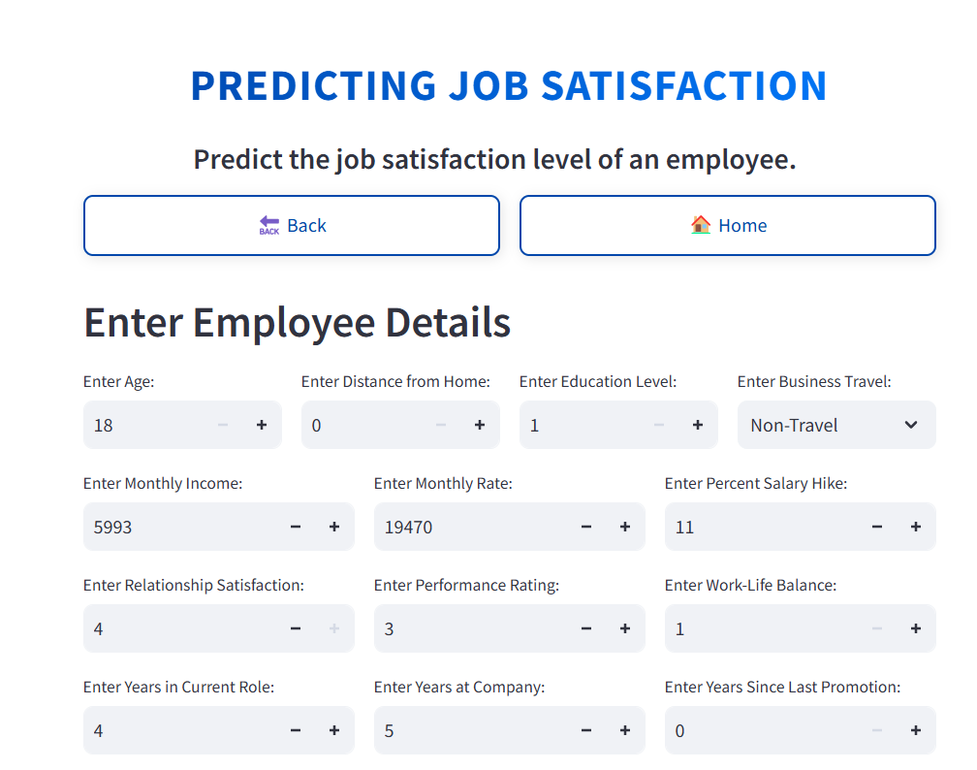
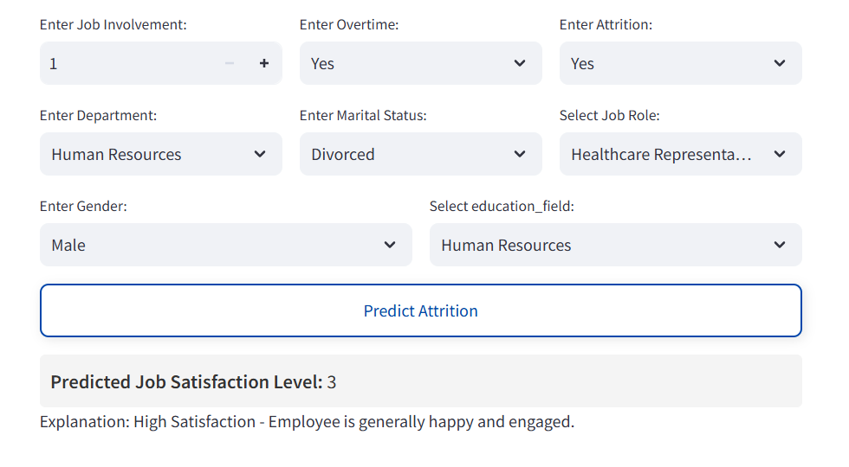
PREDICTION– JOB SATISFACTION

Slide 24
Project Overview
Developed a machine learning model to predict employee attrition using historical HR data.
Key factors analyzed include salary, job satisfaction, work-life balance, and career growth.
Key Findings
Employees with low job satisfaction, frequent business travel, and low salary hikes are more likely to leave.
Work-life balance and relationship with managers significantly impact attrition rates.
Business Impact
Cost Reduction: Early identification of at-risk employees helps reduce hiring and training costs.
Operational Efficiency: HR teams can focus on retention strategies for high-risk employees.
Improved Employee Experience: Personalized engagement plans enhance job satisfaction and loyalty.
Future Scope
Enhance model accuracy with real-time employee feedback.
Integrate AI-driven recommendations for HR interventions.

